Slide 1

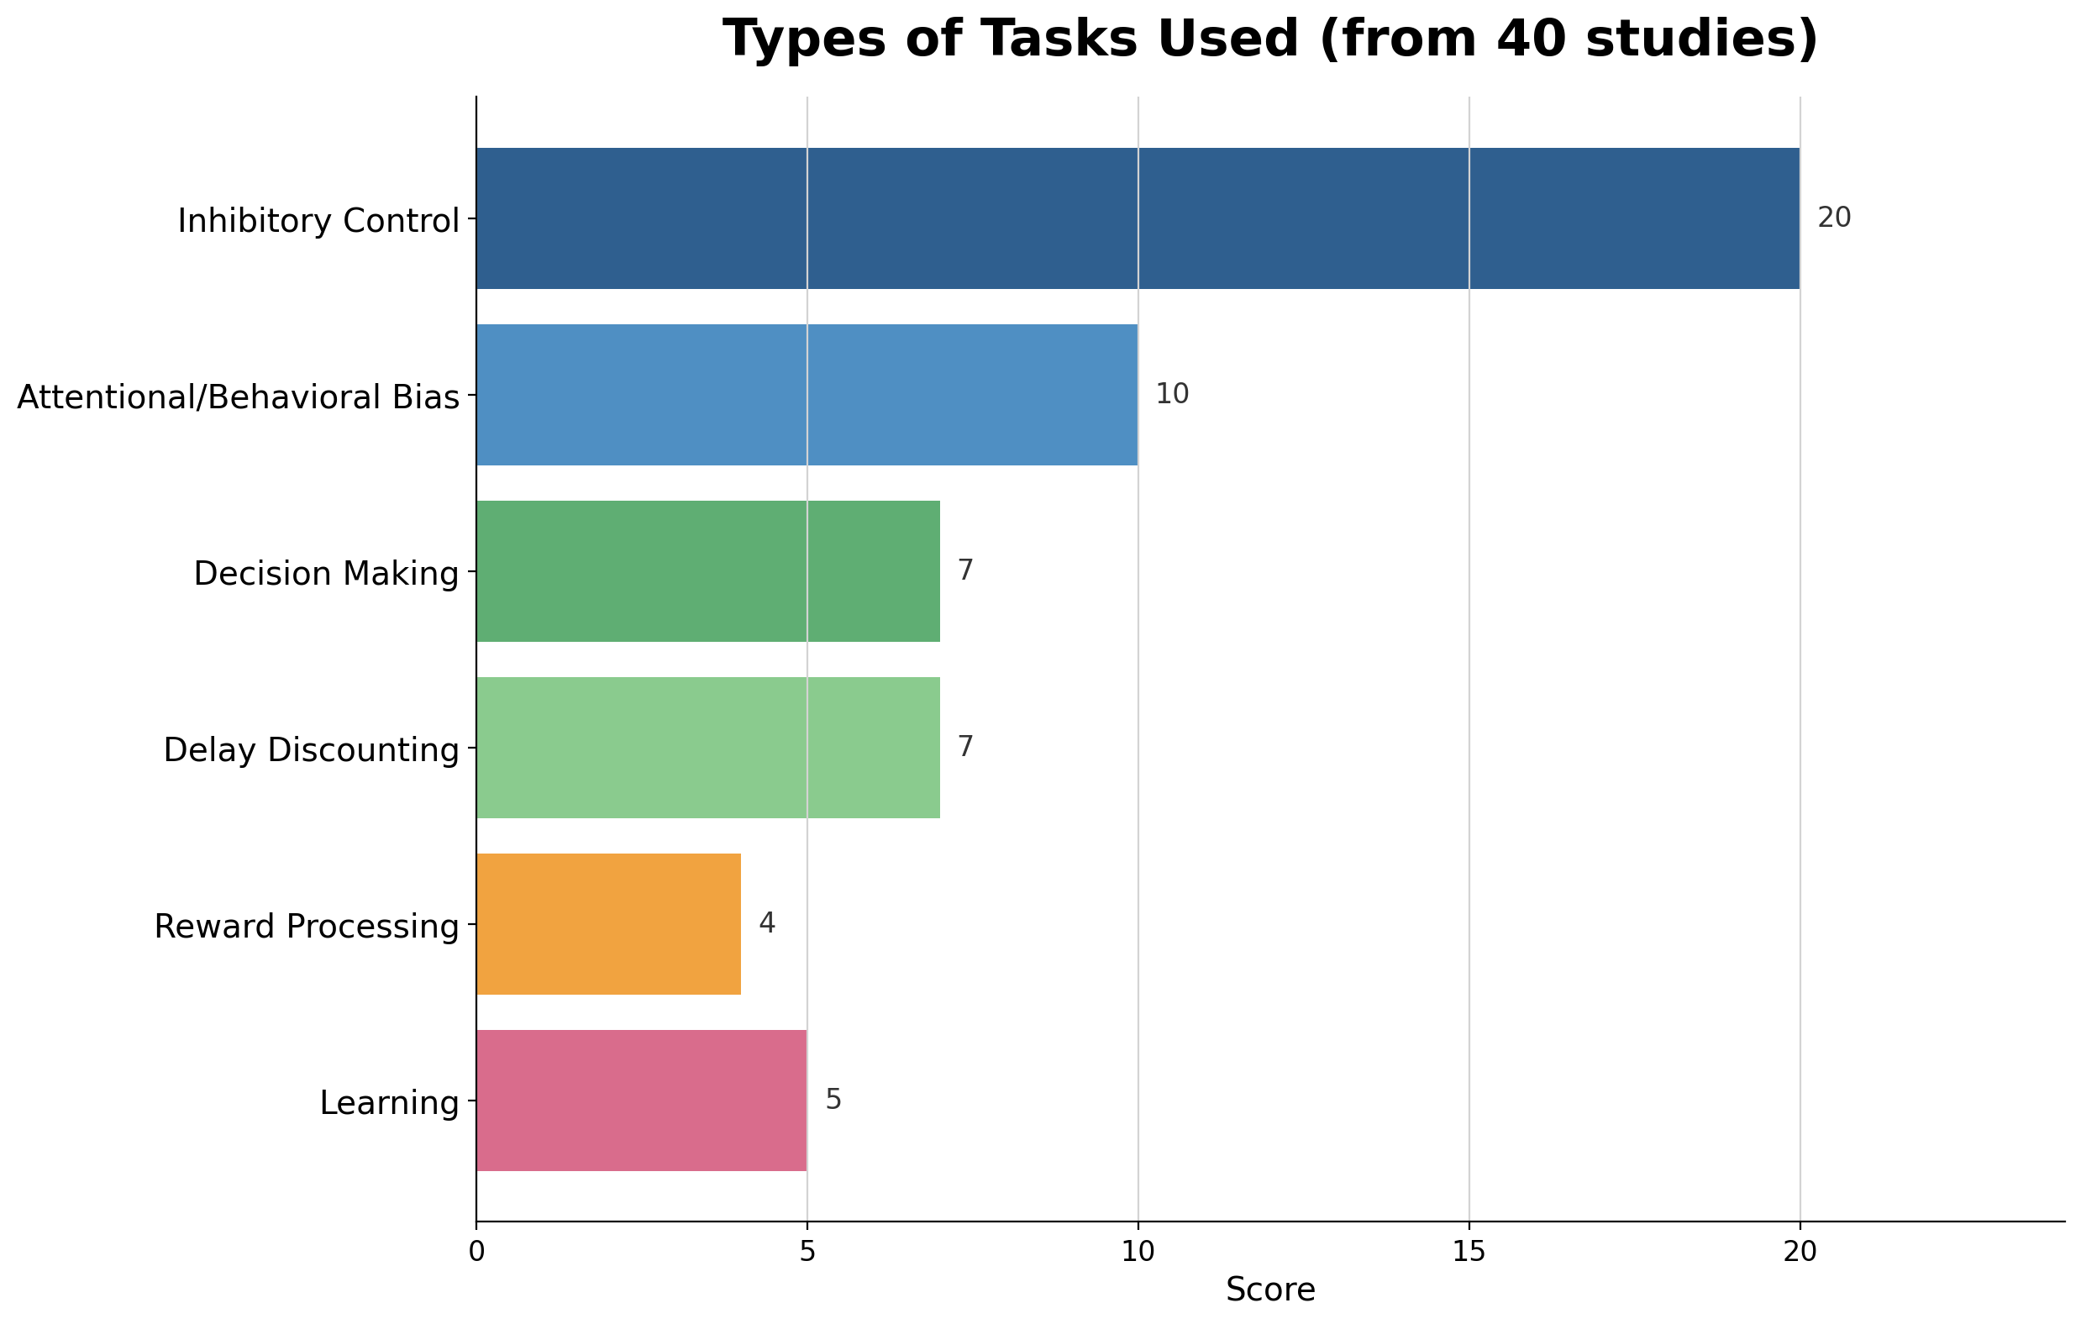
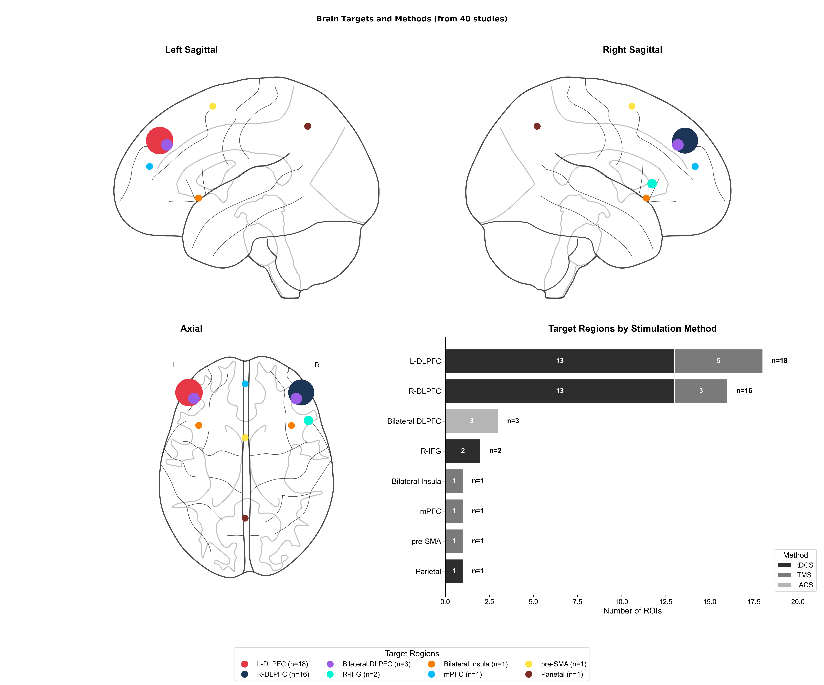
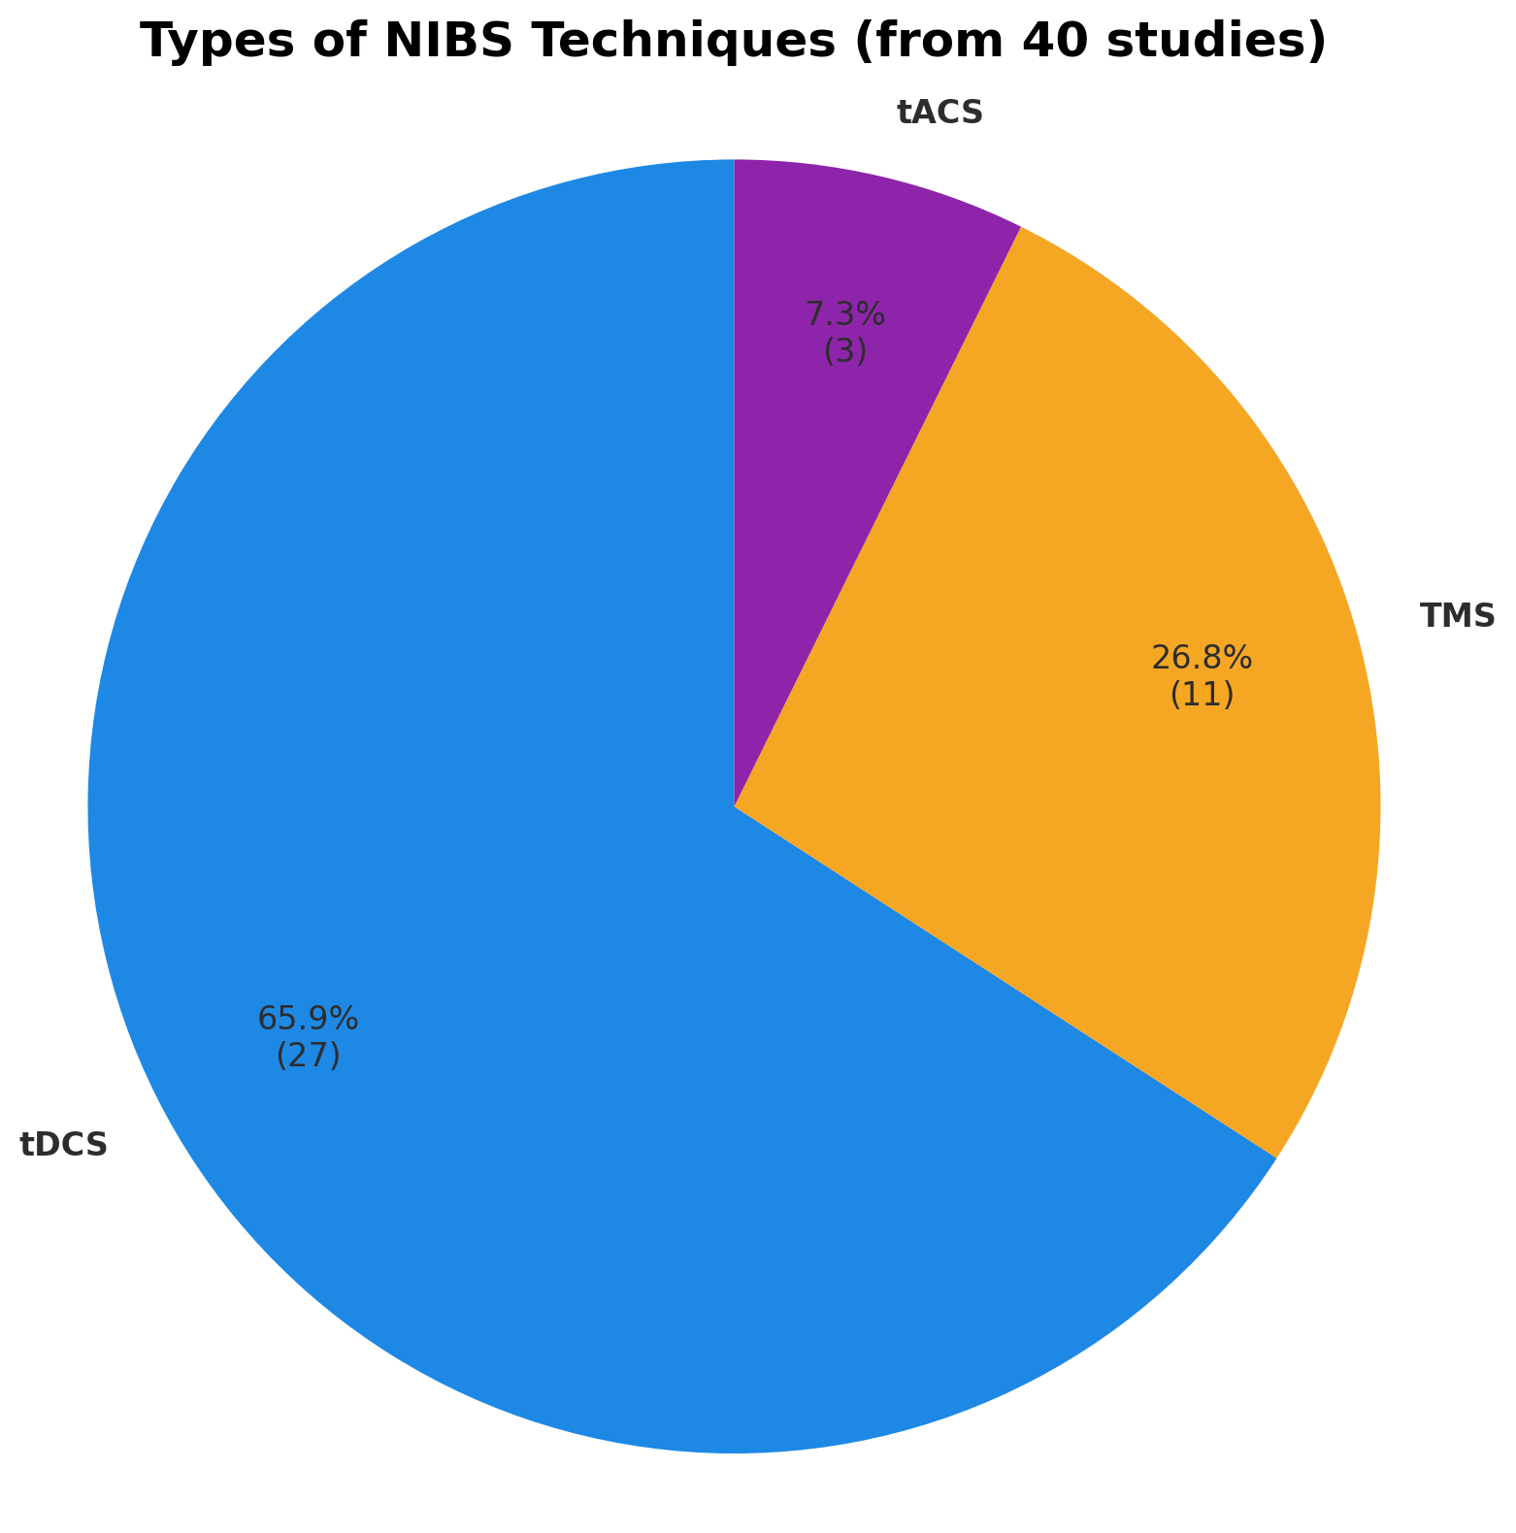
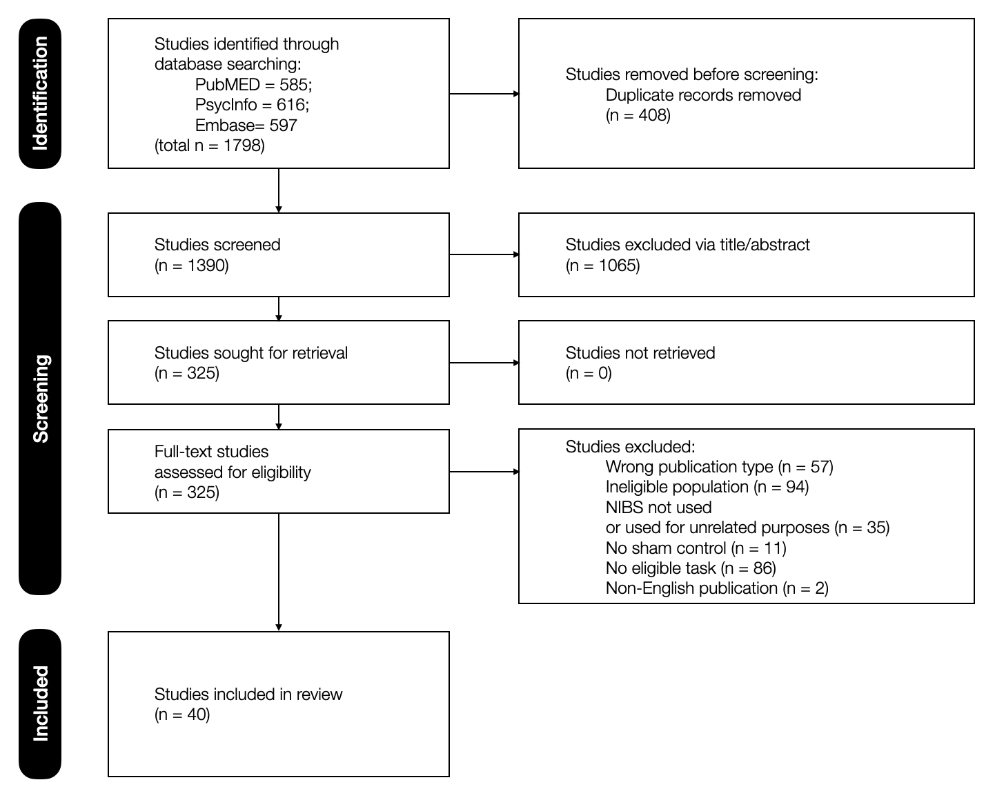

Cognitive Mechanisms of Non-invasive Brain Stimulation
for Substance Use Disorders and Behavioral Addictions:
A Systematic Review
서울대학교 서어서문학과
송승빈
seungbeen512@snu.ac.kr
INTRODUCTION
RESULTS
It has been documented that addiction fundamentally involves cognitive impairments, suggesting the importance of normalizing cognitive dysfunctions to induce significant and long-lasting changes in addictive behavior
Non-invasive brain stimulation (NIBS) techniques have been implemented in addiction treatment, producing meaningful changes in clinical symptoms of addiction, although results have been variable. Increasing number of studies are using NIBS to directly target neural circuits underlying impaired cognition in addictive populations.
Investigating the cognitive mechanisms of NIBS could 1) capture stimulation-induced subthreshold changes in the implicit processes not fully reflected in clinical symptoms, and 2) pave the way for a more effective, reliable, and durable treatment for individuals with distinct cognitive profiles
1) Attentional and Behaivorlal Bias
10 articles, mostly using the Implicit Association Test (IAT) and the Approach-Avoidance Task (AAT)
Studies mostly demonstrated null effects of tDCS in IAT and inconsistent effects in AAT
Although NIBS often paired with cognitive bias modification (CBM) techniques, enhanced effects were inconsistent across these studies.
2) Response Inhibition and Inhibitory Control
20 studies, mostly using the Stop Signal Task (SST) or Go/No-Go task (GNG)
NIBS on dlPFC could enhance response inhibition, although results variant across tasks, sample characteristics, and protocols
NIBS effects on GNG more consistent compared to SST, possibly due to their dissimilar nature (withold versus stop an automatic response).
Enhanced prefrontal-cingulate connectivity found after intervention (strengthened top-down regulation)
3) Valuation and Decision-Making
15 articles, mostly Balloon Analogue Risk Task (BART) and the Game of Dice Task (GDT), measuring risk-taking levels, and delay discounting tasks (DDT), quantifying delay discounting and impulsivity
Risk taking: promising results -> reduced risk-taking levels found even in single-session NIBS treatments (more consistent effects in repeated sessions)
Delay discounting/impulsivity: heterogeneity of results
Evidence points to the superior effects of NIBS combined with cognitive or behavioral training interventions,
OBJECTIVES
This article aims to present the efficacy and limitations of NIBS treatments in modifying cognitive processes relevant to addiction by reviewing available research on NIBS interventions directed towards cognitive impairments in clinical and subclinical populations with addiction
This review of NIBS treatment on addiction is significant both as a thorough summary of up-to-date findings in this growing research area, and as a potential bridge between research and the clinical applications of NIBS-based addiction treatment.
METHODS
The systematic review followed the Preferred Reporting Items for Systematic Reviews and Meta-Analysis (PRISMA) guidelines.
Studies for review were searched on PubMed, PsycInfo, and EMBASE, covering studies published between 2000 and 2025.
Addiction-related, NIBS-related, and cognition-related search terms were used to identify relevant articles.
4) Reward Processing and Learning
8 articles, Monetary Incentive Delay (MID) task, and the T-maze task, for measuring blunted sensitivity to rewards, and Iowa Gambling Task (IGT), to assess learning and decision-making under ambiguity
Prefrontal rTMS could enhance reward-related neurophysiological responses (“reward positivity”: an essential signal for value updating in reinforcement learning)
No changes found in reward anticipation measured in MID
Enhanced task performance consistently found in IGT, but assesments were constrained to the overall augmentation in performance without examination of the sophisticated task regarding learning, ambiguity processing, and decision making
CONCLUSIONS
This review highlighted the importance of targeting cognitive mechanisms in NIBS-based addiction treatment and reported documented attempts to mitigate cognitive dysfunctions with the purpose of treating addiction
While former studies tilted towards targeting more implicit, rudimentary areas of cognition, future studies should make more use of intricate cognitive tasks to map the complex & dynamic processes of cognitive behavior relevant to addiction.
Future studies should adopt computational models for a more refined understanding of addiction and identification of possible intervention targets.

